Slide 1
Project 3 | Roadmap
Groep 3 | Vincent de Heer, Tjitse Venema, Walid el Hasnaoui, Alex koppendraier

Slide 2
Inhoud
Concept
Inbreng teamleden
Probleem punten en verbeteringen voor de toekomst
Demonstratie
Gerealiseerde features
Vragen

Slide 3
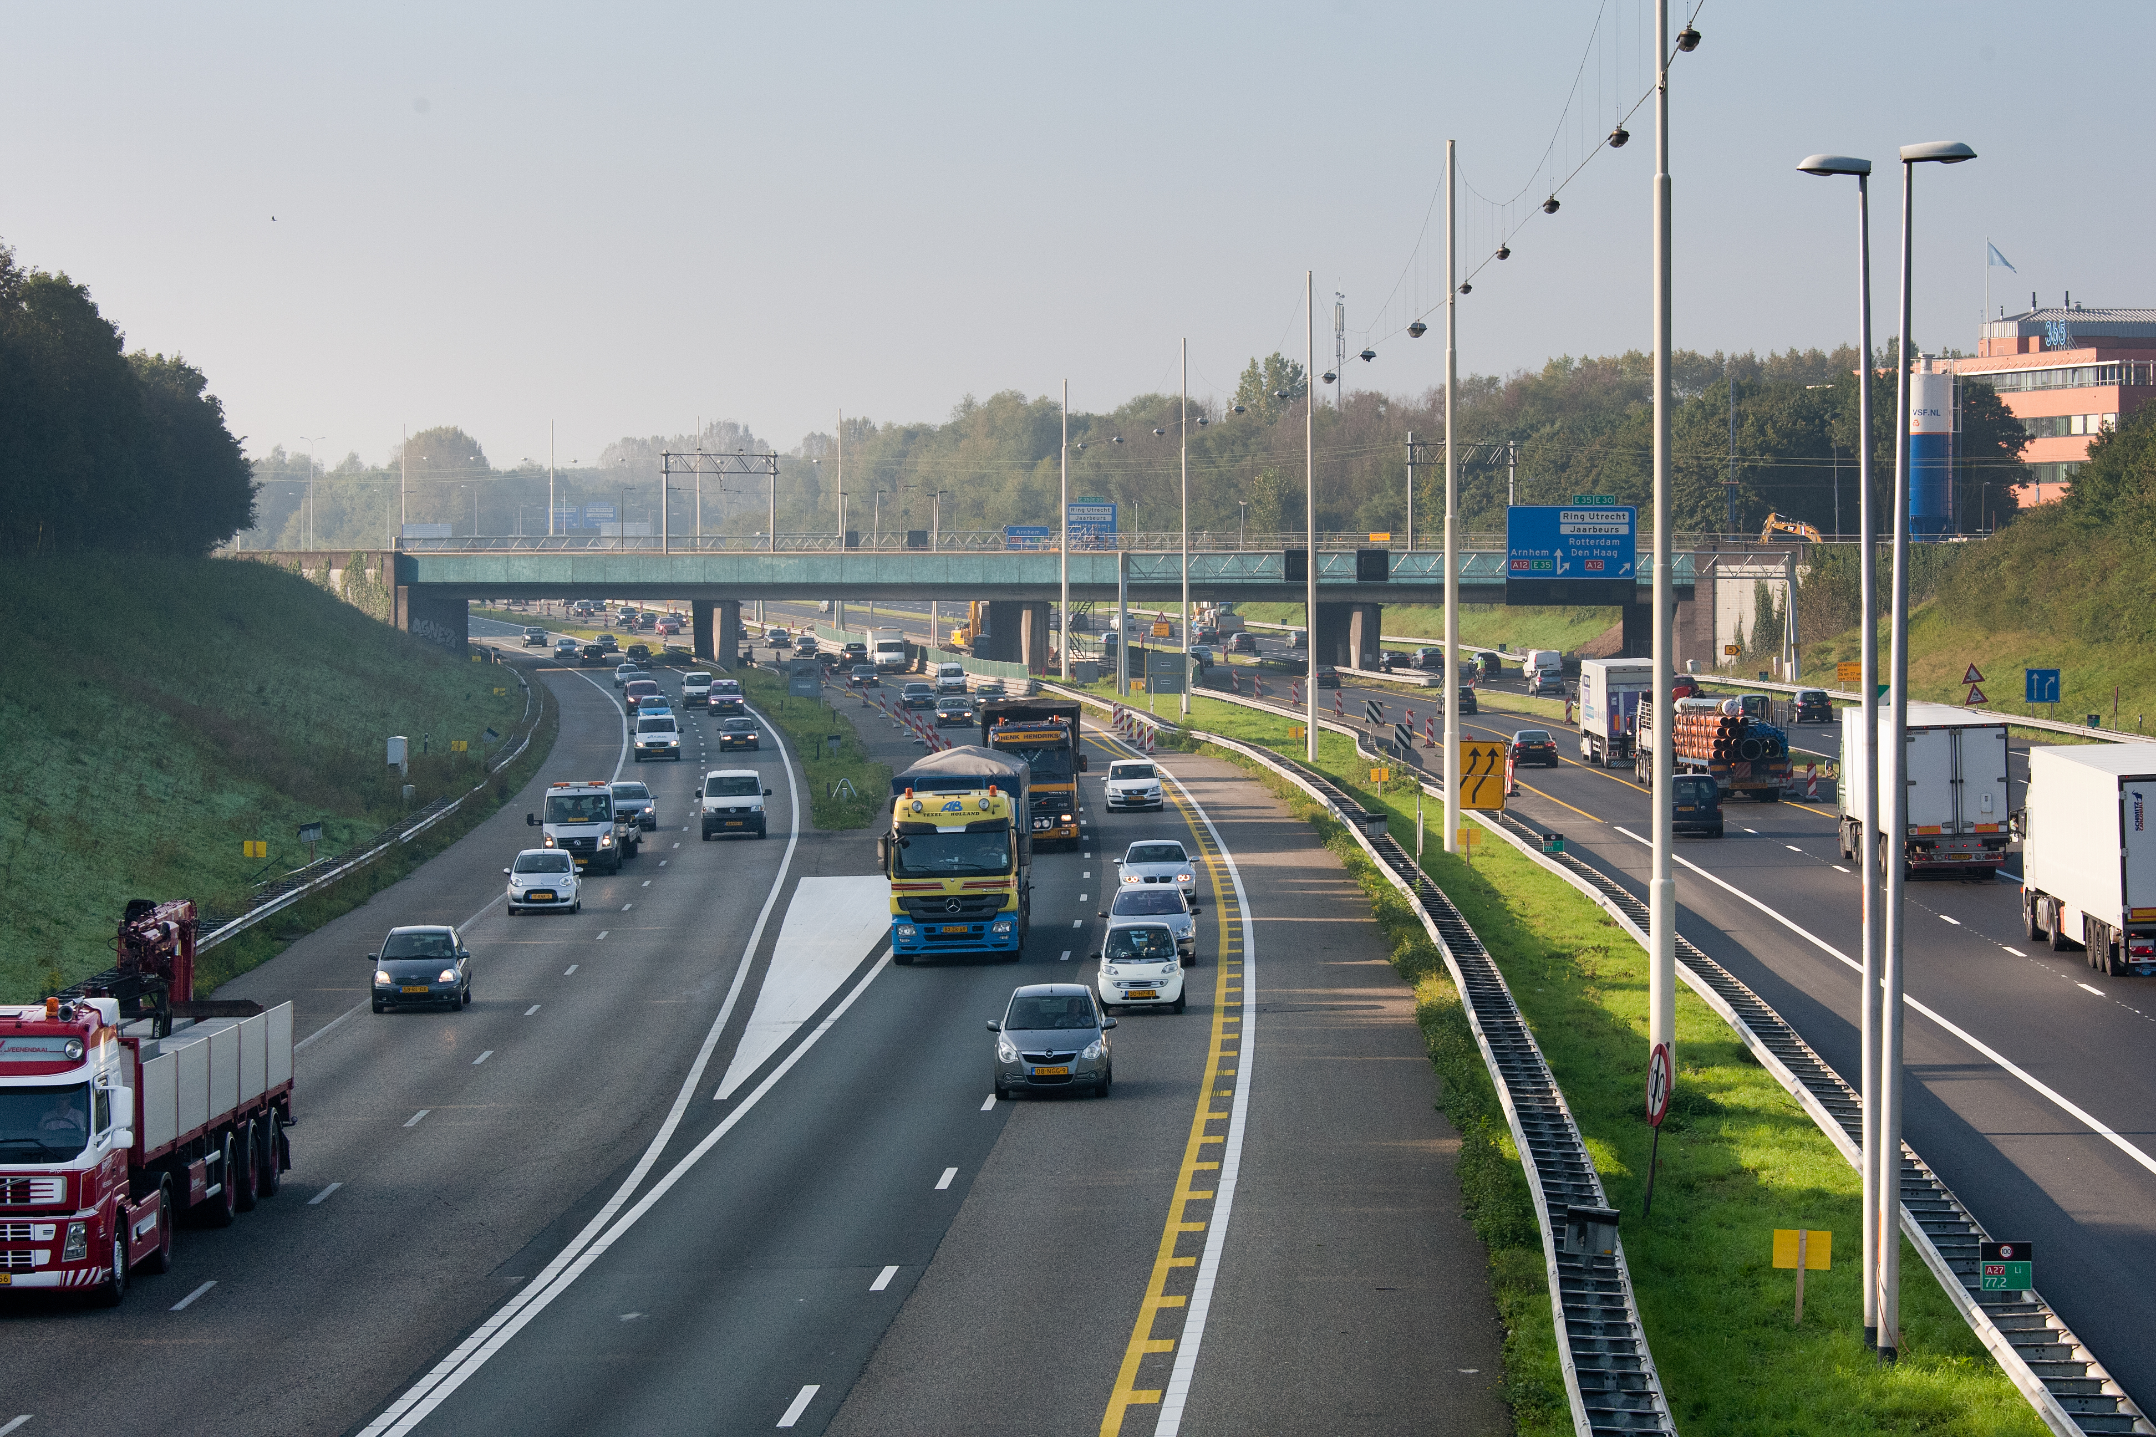
concept
Snelwegen
Ongevallen
Beoordeling

Slide 4
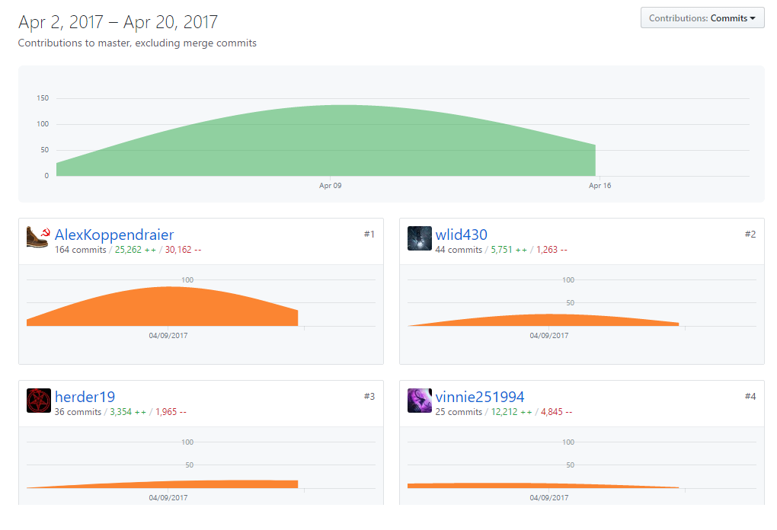
Inbreng van teamleden

Slide 5
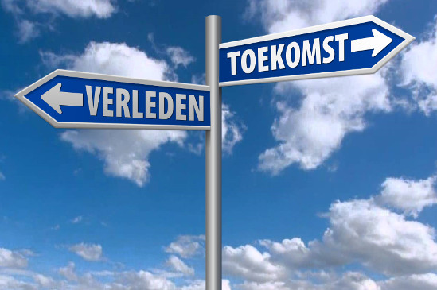
Probleem punten en verbeteringen voor de toekomst
Walid
Tjitse
Vincent
Alex

Slide 6
Gerealiseerde features
A database contains all the necessary data
There is a GUI from which you can access and interact with the data (e.g. by filtering or selecting)
The applications shows at least two different plots (e.g. goo.gl/DPpWtC | Graph Selection Matrix - Perceptual Edge) including legend/explanation
There is at least one query on data combined from multiple data sources

Slide 7
Gerealiseerde features
There is a parser which imports data in the DB
There is a UML 2.0 Use Case and Activity Diagram of the whole application
The GUI contains a 2D visualization of the city showing animated data on it
Additional feature proposed by you and approved by your P.O.

Slide 8
Demonstratie

Slide 9
Vragen?

